Slide 1
Plant Nurture System
sddec24-16
Cameron Jones, Blake Hardy, Cayden Kelley, Chase O’Connell, Holden Brown, Tejal Devshetwar
Advisor: Ahamed, Md Maruf

Slide 2
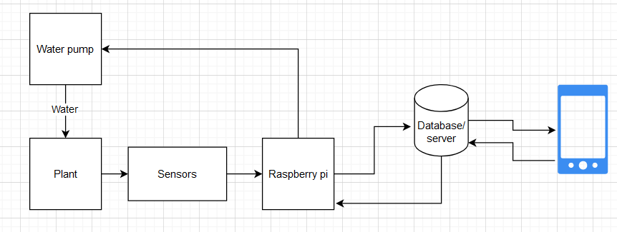
Project Overview
Create a device that automatically collects soil data (NPK,moisture,temperature).
Sends the data to a database on a server.
Create a mobile app which presents the collected data to the users.
Server has logic that sends commands to automatically water/fertilize plants when certain conditions are met.

Slide 3
Detailed Design and Visuals
Overall:
Data from sensors are transferred to Microcontroller.
Data from microcontroller transferred to database which in then is displayed on the app.
Database returns commands to actuate water pump.

Slide 4

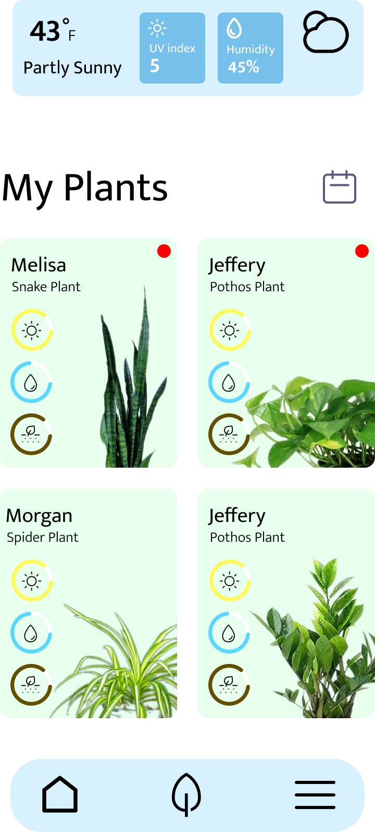
Detailed Design and Visuals
App:
The temperature, UV Index, Humidity are obtained through API and updated based on current location.
Each card opens up detailed information about each plant.

Slide 5
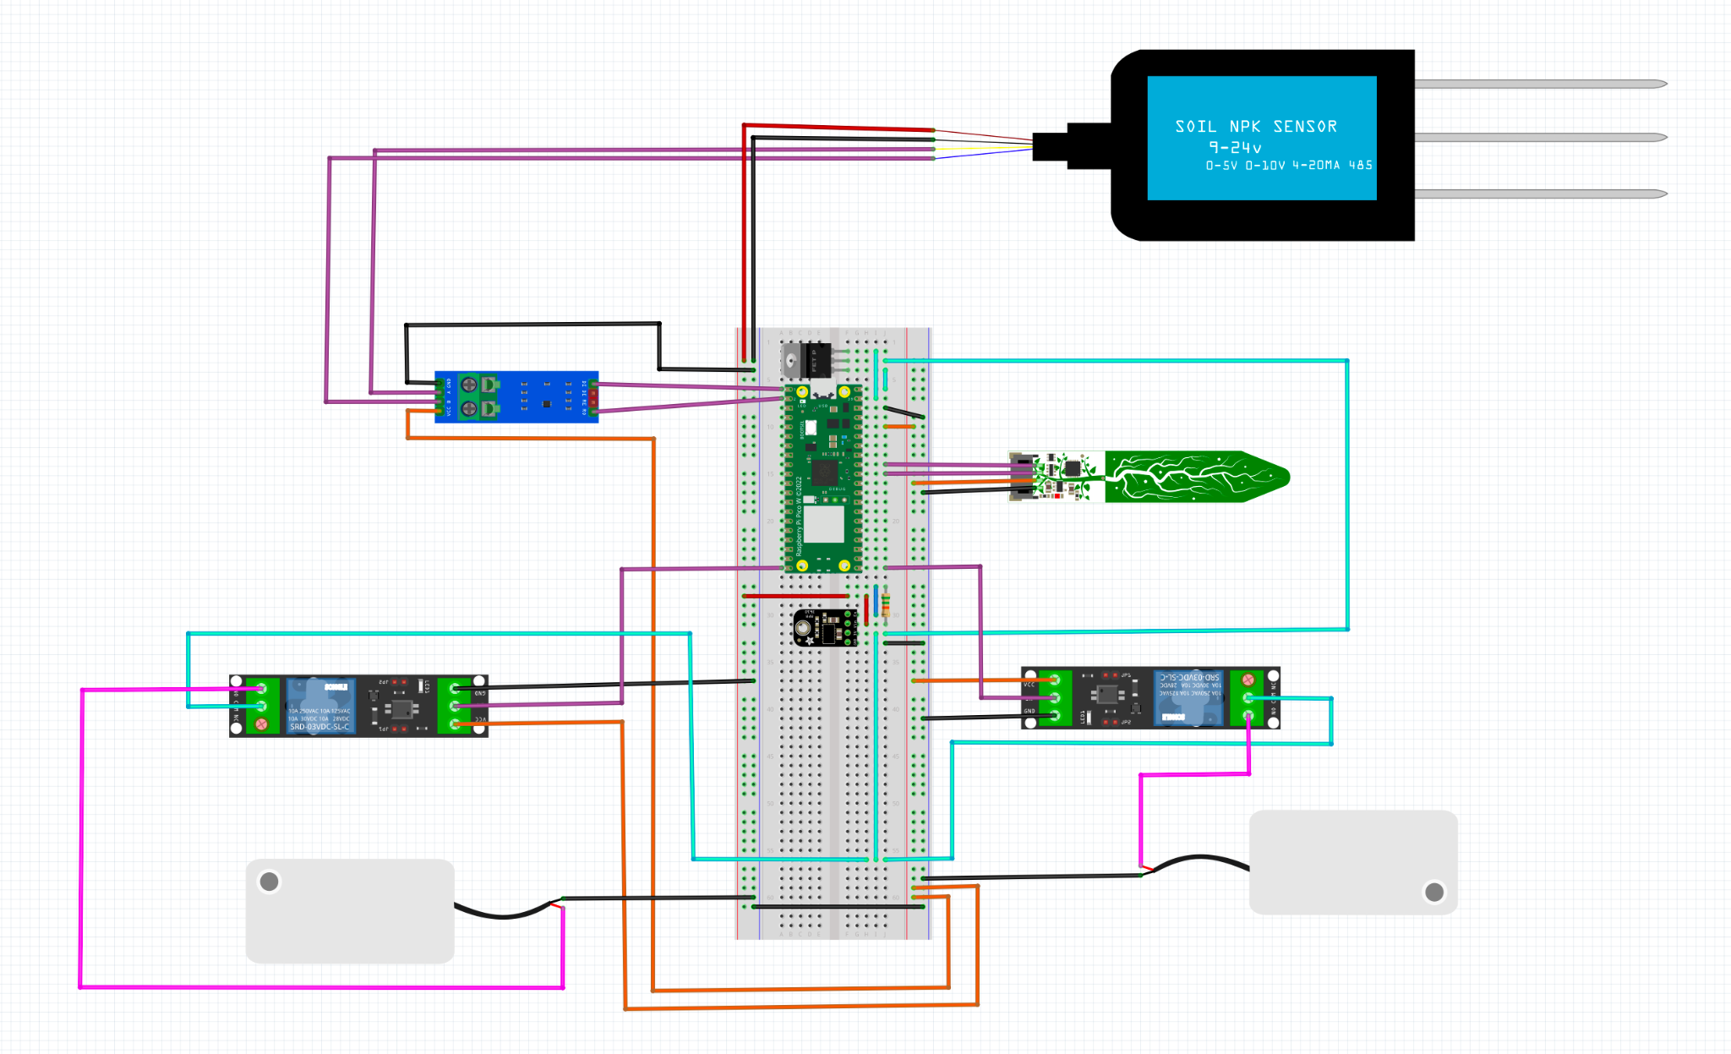
Ground
12 V Power
3.3 V Power
Pico Power Out
Nitrogen, Phosphorus, and Potassium Sensor
Switched 3.3V
Communication
RS485 to UART converter
Soil Moisture & Temp. Sensor
Relays
Water Pumps

Slide 6
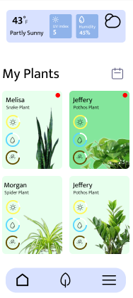
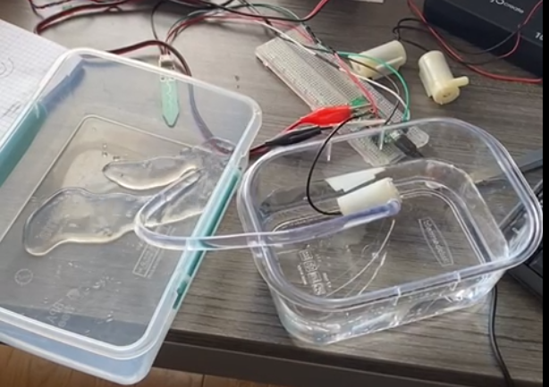
Functionality: System Overview
Mobile App: Central hub for user interaction and data visualization.
Sensor System: Monitors nutrients, storing data in the cloud.
Actuators: Automatically dispense nutrients based on plant needs.
Mobile app view of user created plants
Water actuator dispensing

Slide 7
Functionality: Key Features
Multiple Plants and Sensors: Manage several plants and corresponding sensors.
Plant Profiles: Create a unique profile for each plant.
Automated Nutrient Dispensing: Actuators respond to sensor data, ensuring optimal plant health.
Mobile app view of user created plants
Water actuator dispensing

Slide 8
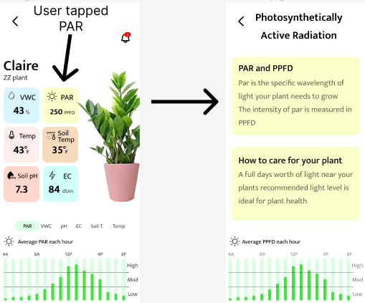
Functionality: Key Features
Data-Driven Insights:
Real-time monitoring of sensor data.
Graphical representation of sensor data for easy interpretation.
Smart Notifications:
Reminders and alerts tailored to each plant's care schedule.
Explanation of sensor metrics.
User tapping PAR and receiving a detailed explanation

Slide 9
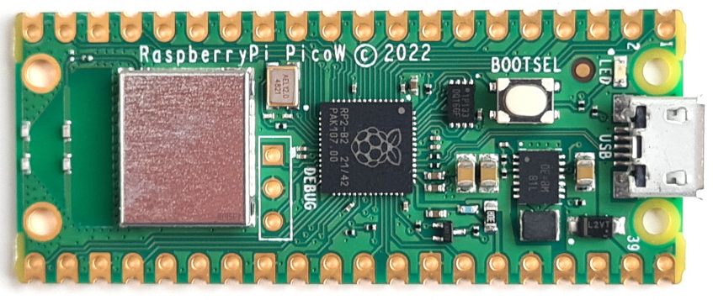
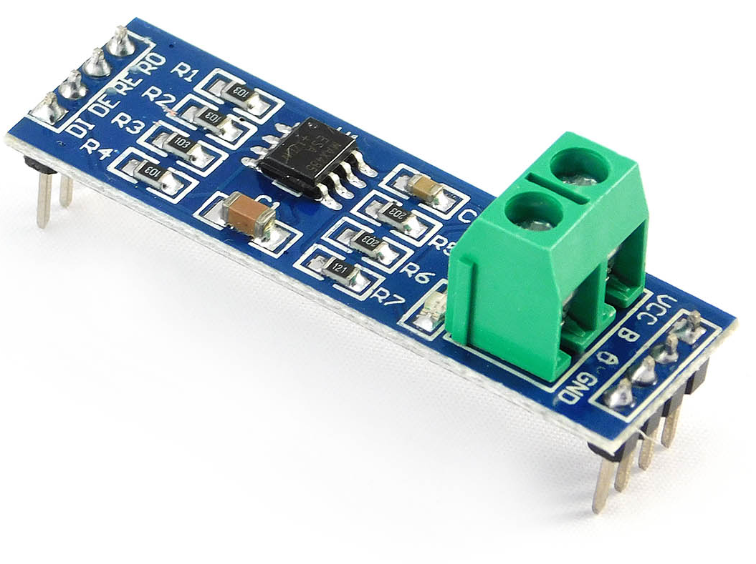
Technology Considerations
Raspberry pi pico w
Small form factor
Low power and heat
Wireless communication
Sufficient IO capability
Good software support
AWS server
Ease of use
Low cost
I2c sensors
Simple
Easy part availability
Low component cost
Rs485 sensors
Limited choices
Good hardware and software support
Notes:
Compute power is not a concern with this device. All its doing it getting sensor data and relaying it to a server. Anything with more compute is not necessary, the pico is already overkill. In theory it does allow us to implement advanced features a more minimalist microcontroller would not. Not that we plan to. The pico is also much cheaper than a regular pi Heat is a problem in an enclosed space and adding a cooling solution would make waterproofing much more difficult. AWS because its free up to a certain threshold which we probably will not hit. I2c cause its everywhere, modbus cause we dont have a choice but its not too difficult to work with. Ideally we would be using more and higher quality sensors, but those are expensive.

Slide 10
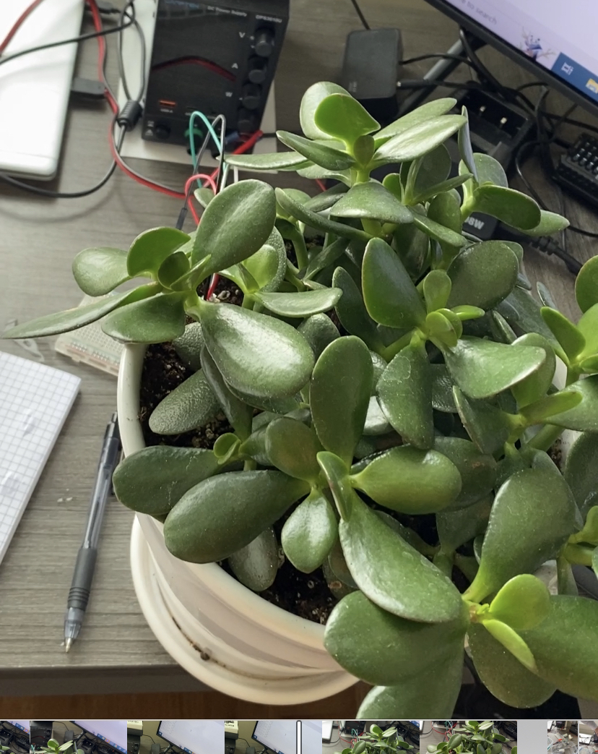
Areas of Concern and Development
Satisfying Requirements
Successful calibration per plant
Effectiveness of auto-fertilization
Meeting User Needs
Hobbyist level peripherals (Budget)
Limited precision
Quality required for research an industry
Appearance & Form Factor
Benefit over manual care
Potential Change in Scope

Slide 11

Conclusions
Key Components:
App
Server Communications
Device (Sensors, Actuators)
Technology Selection
Raspberry Pi Pico
I2C Sensors
RS485 Sensors
Areas of Concern
Quality and Precision
User-base

Slide 12
Questions?

